Slide 1

ASP.NET Core web app with user data protected by authorization
GROUP 3:
Samarpan Pandey – 200492080
Suheet Sonawane - 200493886
Priya Jogani - 200523921
Big Data Analytics
Information Encoding Standard

Slide 2

Project Summary:
This Project is about creating a 3-level Authentication and Authorization to access and manipulate data in an ASP.Net web app in Visual Studio 2022 with .Net 6.0,
The 3 Level of security groups are:
Registered Users : can view all the approved data and can edit/delete their own data.
Managers : can approve or reject contact data. Only approved contacts are visible to users.
Administrators : can approve/reject and edit/delete any data.

Slide 3
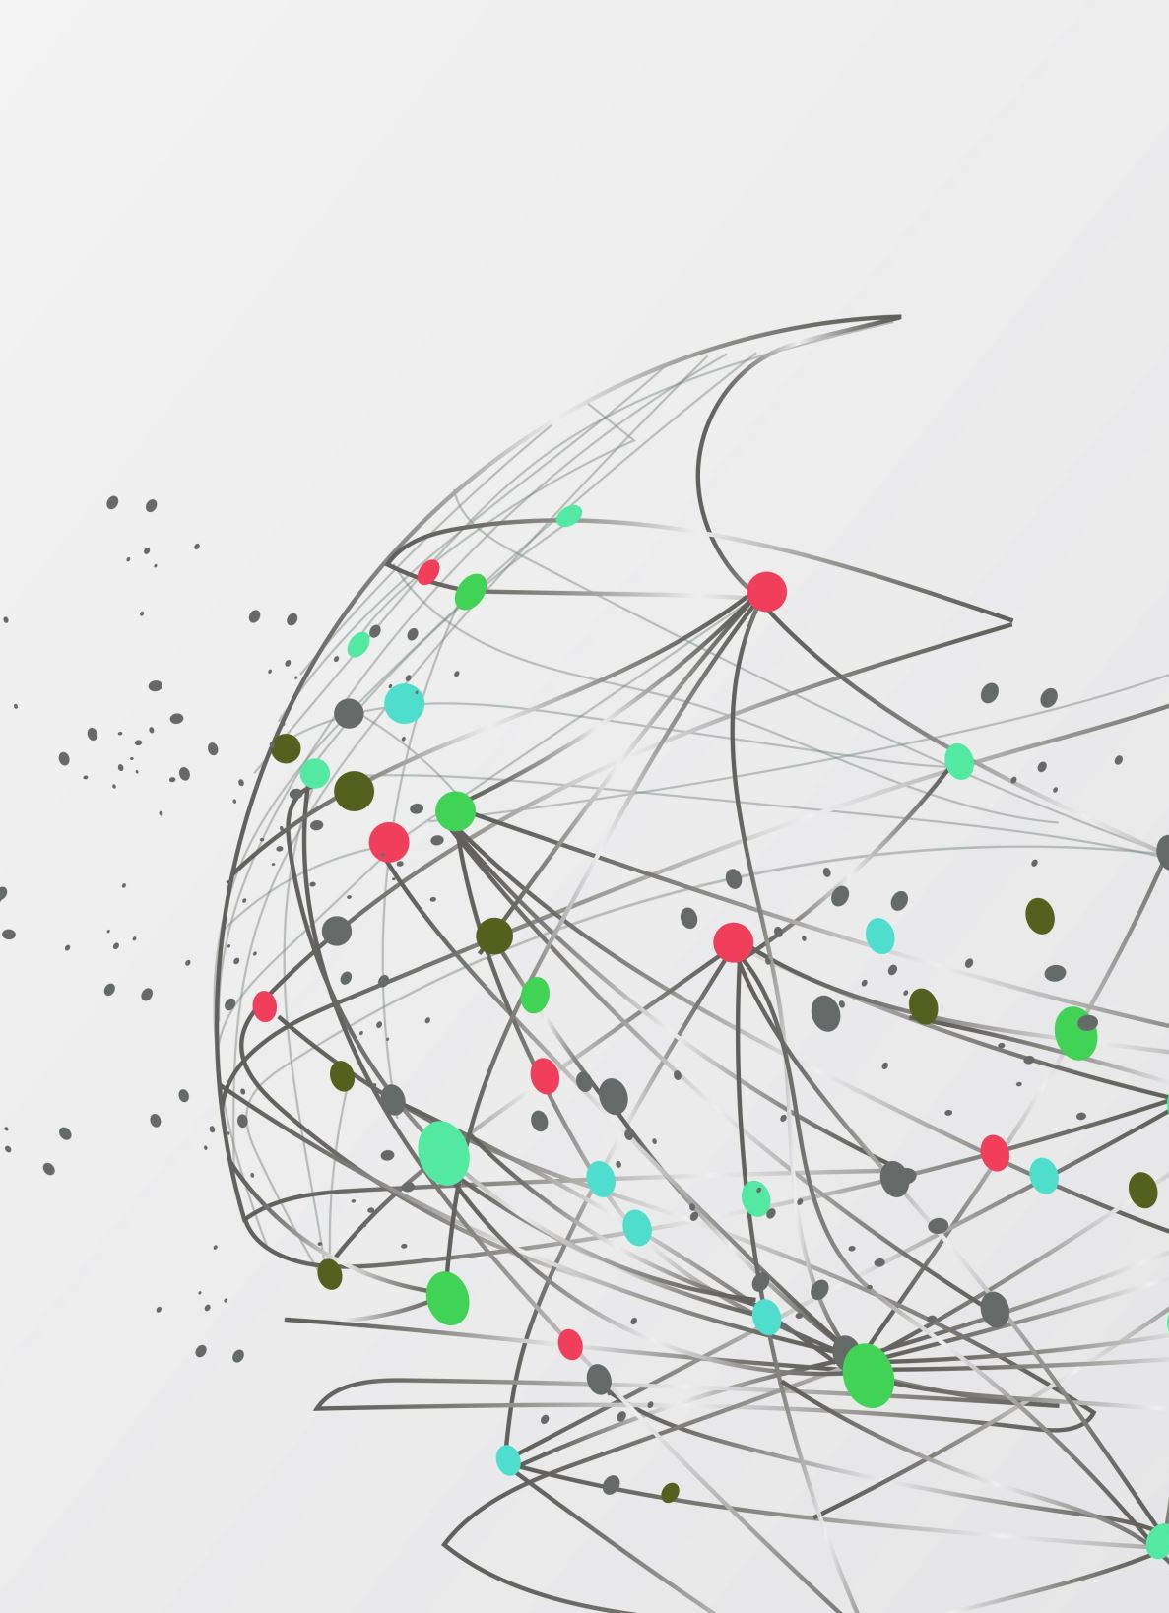
Resources and Packages required for this Project:
Visual Studio 2022
SQL Server Management Studio
.Net 6.0
NuGet Package installer
Packages to be installed in VS 2022:
Microsoft.EntityFrameworkCore.SqlServer
Microsoft.EntityFrameworkCore.Tools
Microsoft.AspNetCore.Identity.EntityFrameworkCore
Microsoft.AspNetCore.Authentication.JwtBearer

Slide 4



About the Team
Suheet Sonawane (Admin)
Recently completed Post-Grad Certificate Degree in AI at Georgian College
Samarpan Pandey (Manager)
Recently completed Post-Grad Certificate Degree in AI at Georgian College
Priya Jogani (User)
Recently Graduated as a software developer from Jai Hind College.

Slide 5

Part 1: User Data Protected by Authorization

Slide 6
What is Authentication?
Determines whether users are who they claim to be.
Challenges the user to validate credentials (for example, through passwords, answers to security questions, or facial recognition).
Usually done before authorization.
Generally, transmits info through an ID Token.
Generally governed by the OpenID Connect (OIDC) protocol.
Example: Employees in a company are required to authenticate through the network before accessing their company email.

Slide 7
What is Authorization?
Determines what users can and cannot access.
Verifies whether access is allowed through policies and rules.
Usually done after successful authentication.
Generally, transmits info through an Access Token.
Generally governed by the OAuth 2.0 framework.
Example: After an employee successfully authenticates, the system determines what information the employees are allowed to access.

Slide 8
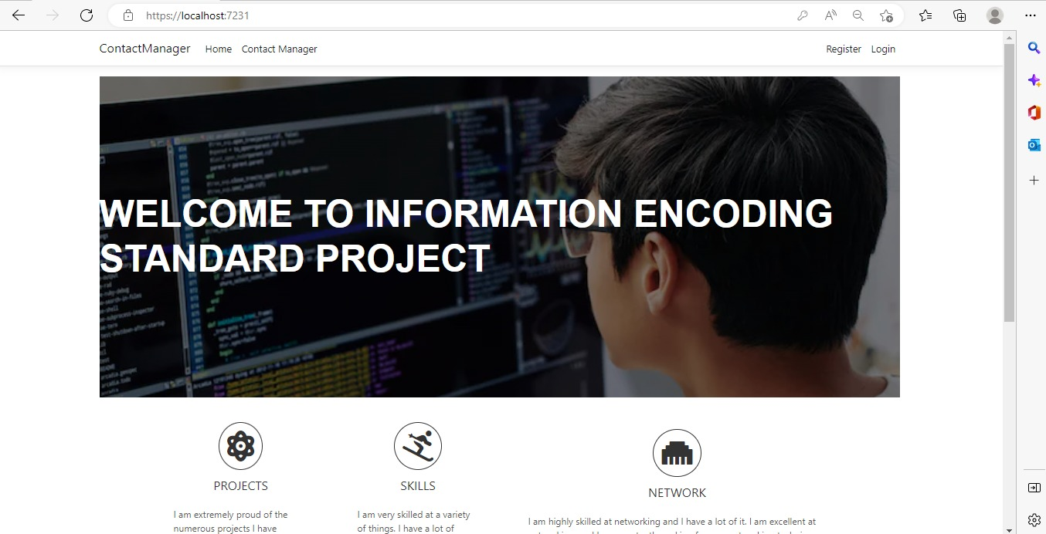
Home page:

Slide 9
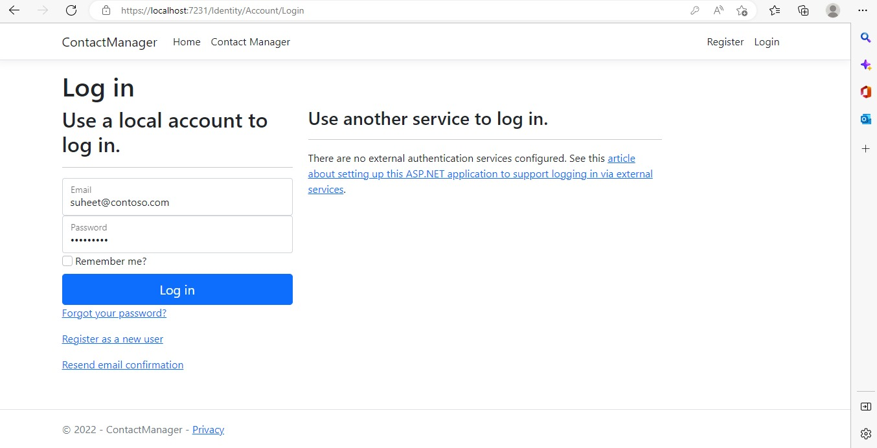
Admin Login :

Slide 10
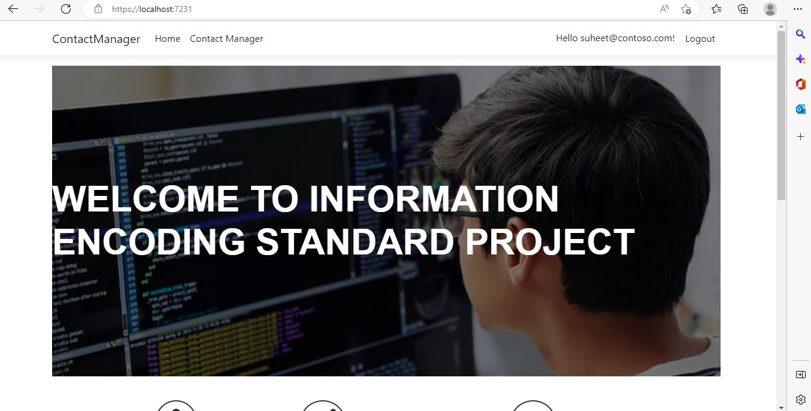
Login Successful

Slide 11
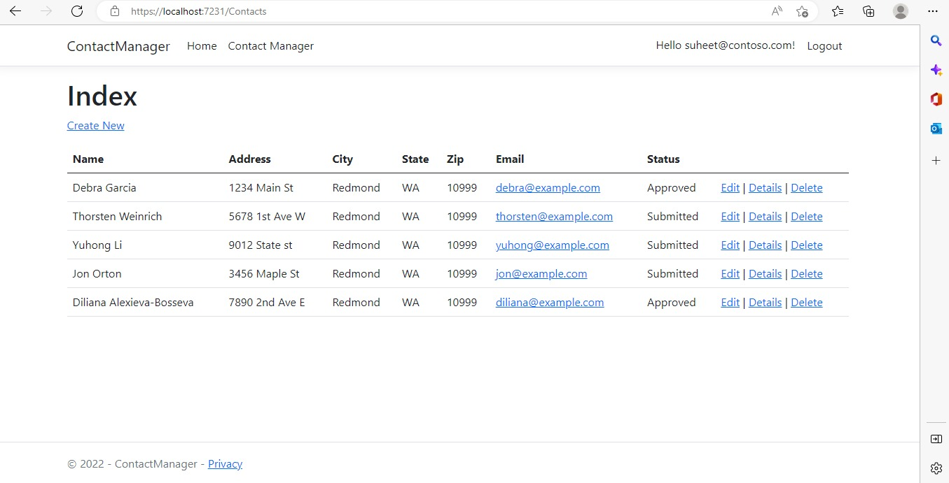
Admin side user data page

Slide 12
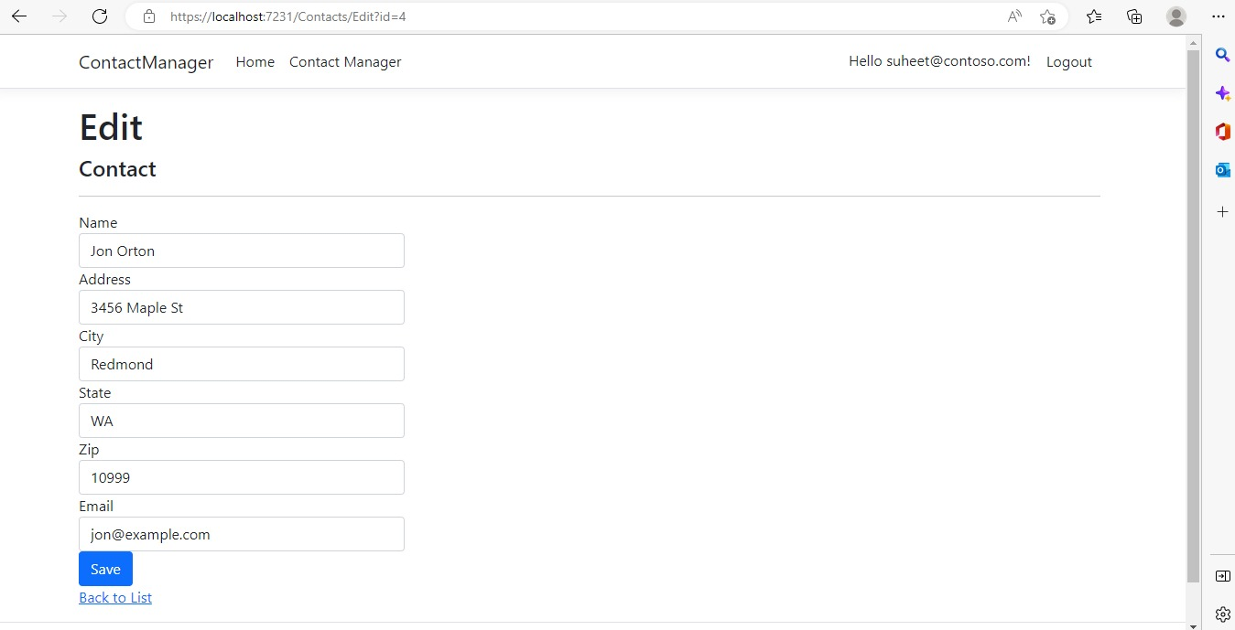
Edit contact page

Slide 13
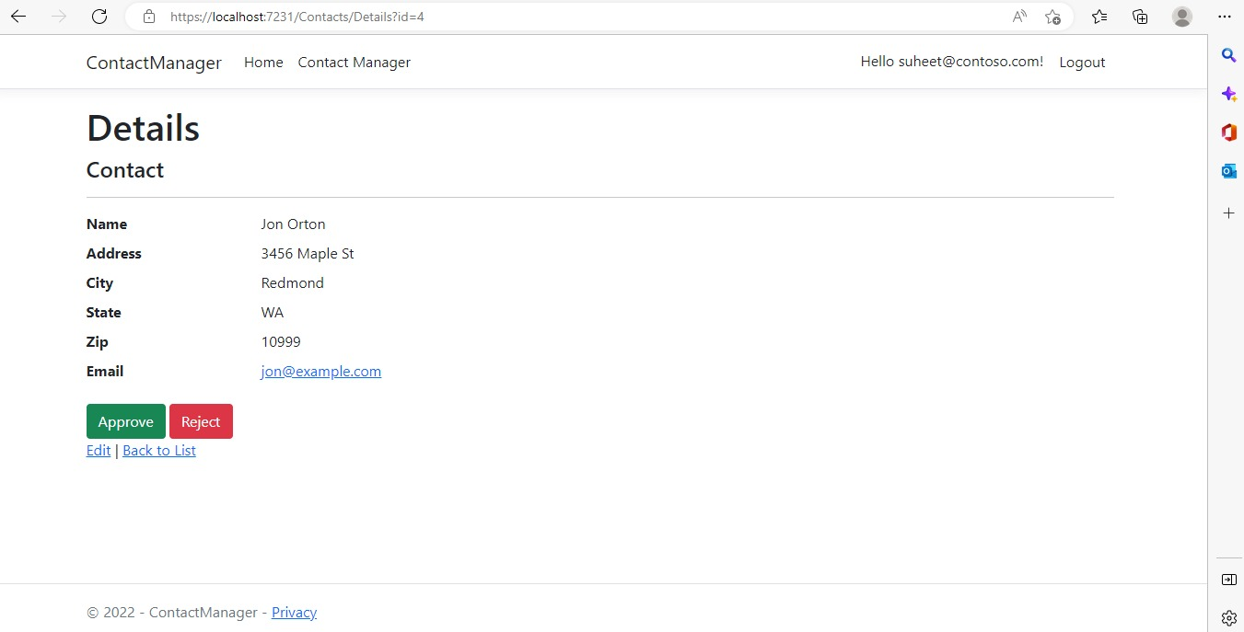
Admin Side : Contact Details Page
Here we can see the Admin side options/authorization to the user data.

Slide 14
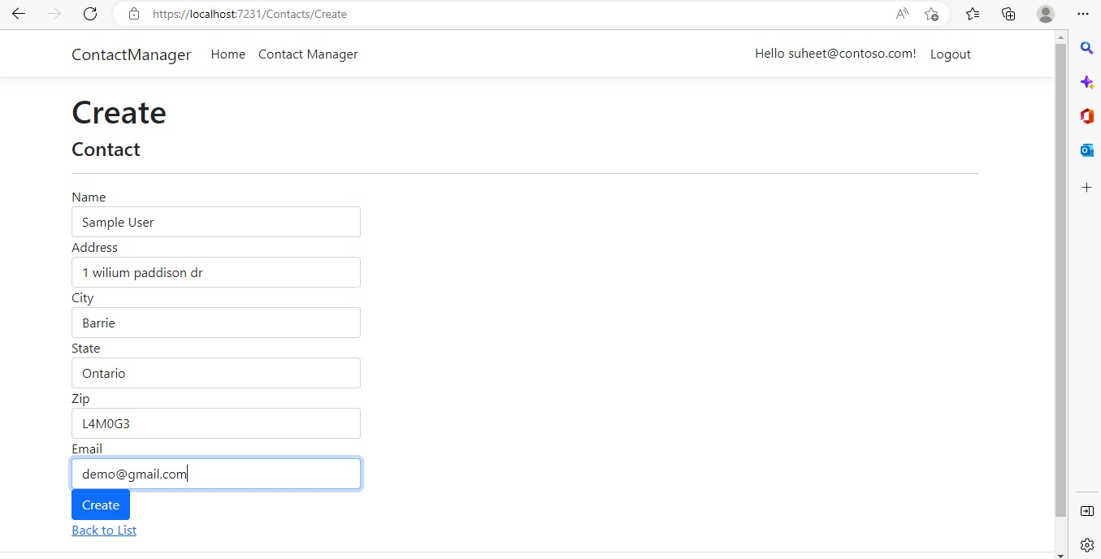
Creating a New Contact

Slide 15
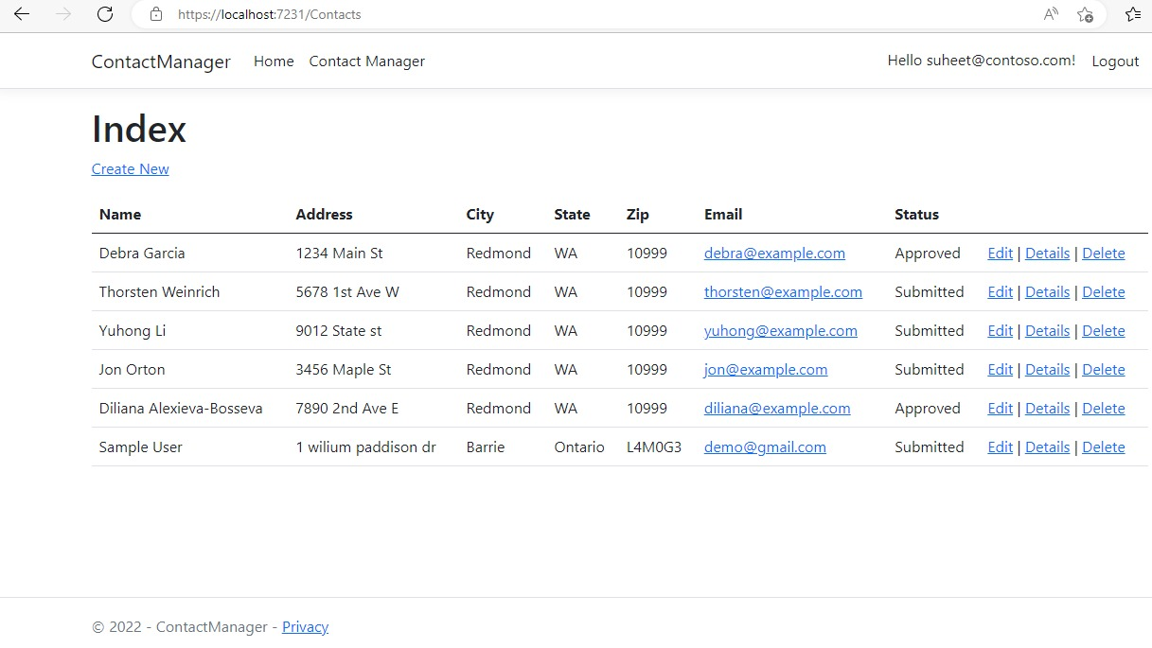
We can see the new user added to the Contact Data List

Slide 16
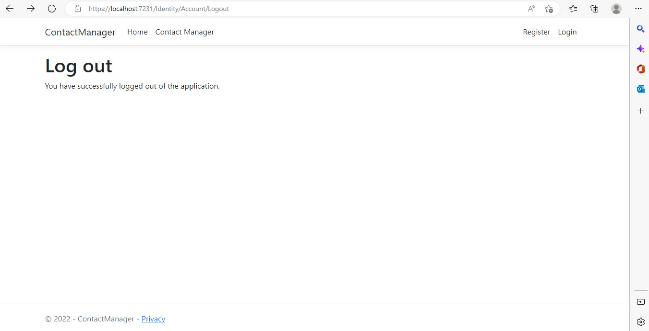
Logout page

Slide 17
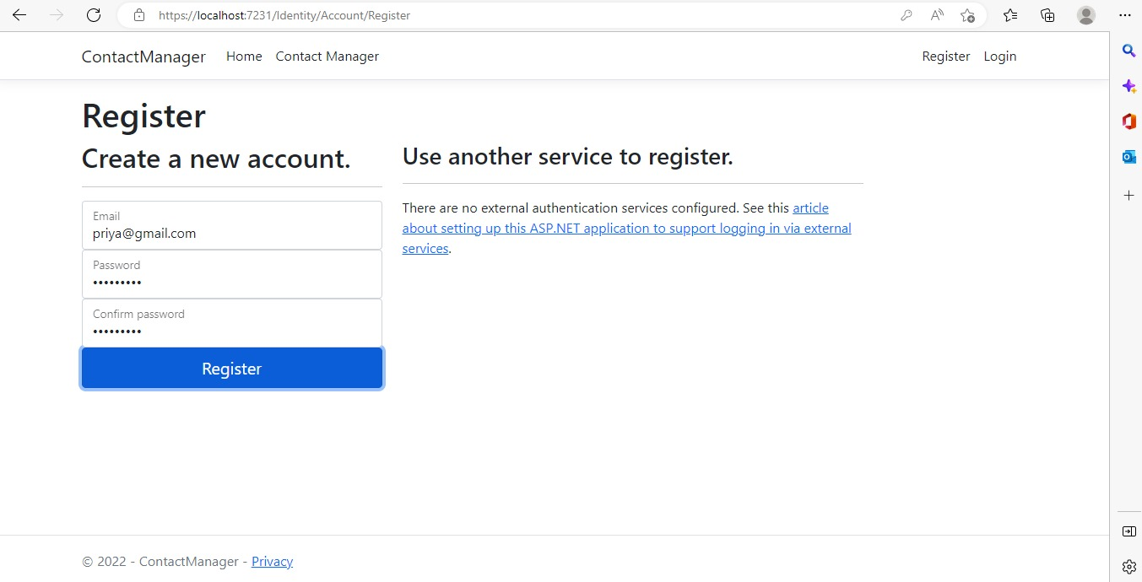
Registration Page
Here we add the New user with User-Level Authorization to the Data.

Slide 18
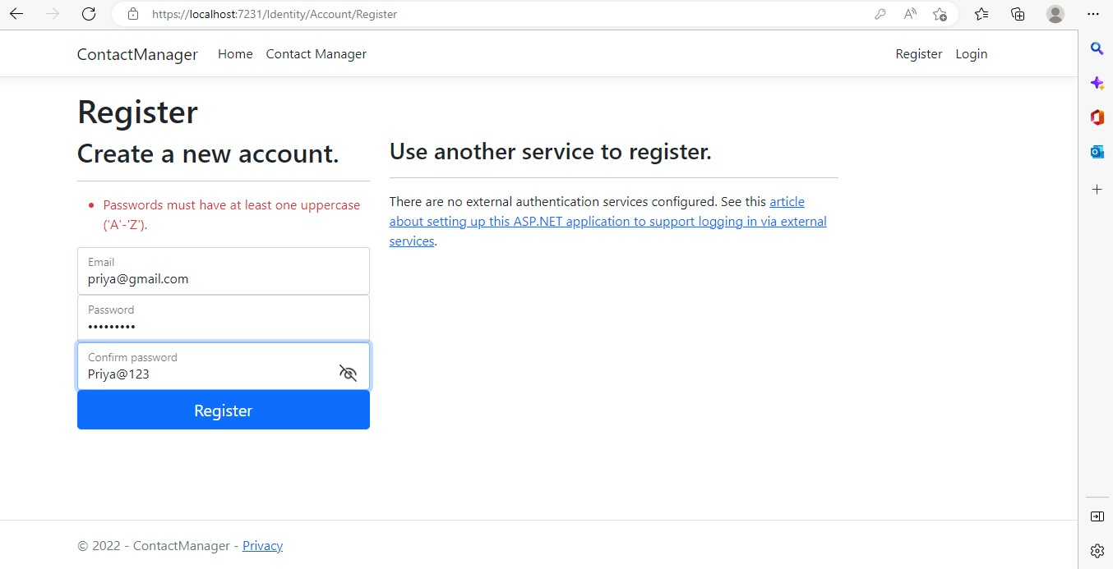
Password Validation for secure login

Slide 19
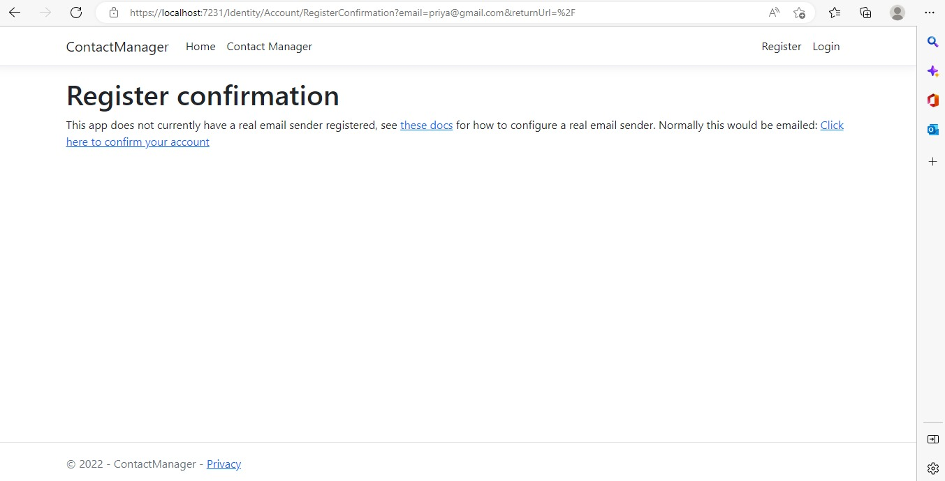
Confirmation Page of Registration.
User gets a confirmation page after entering details to Activate his/her account.

Slide 20
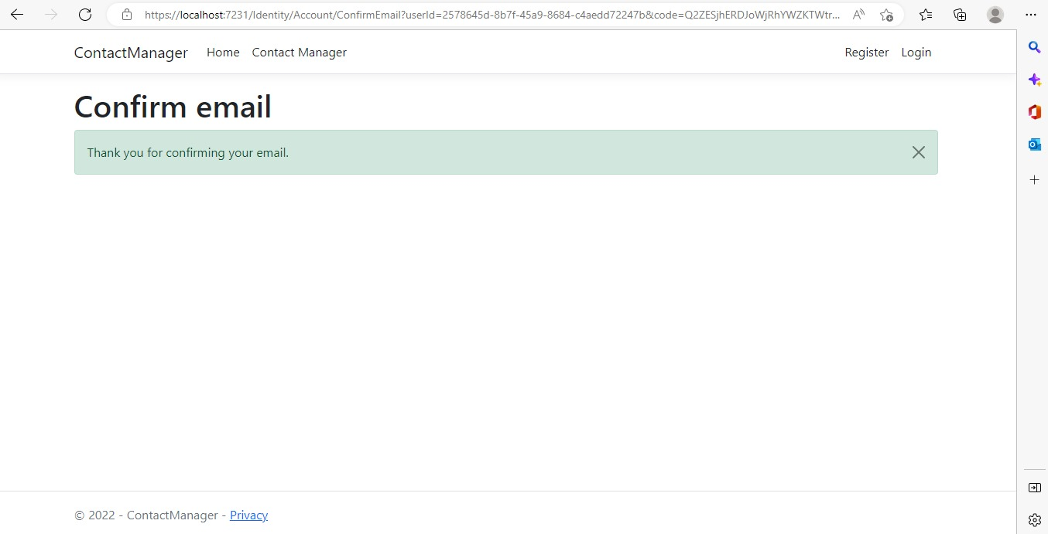

Slide 21
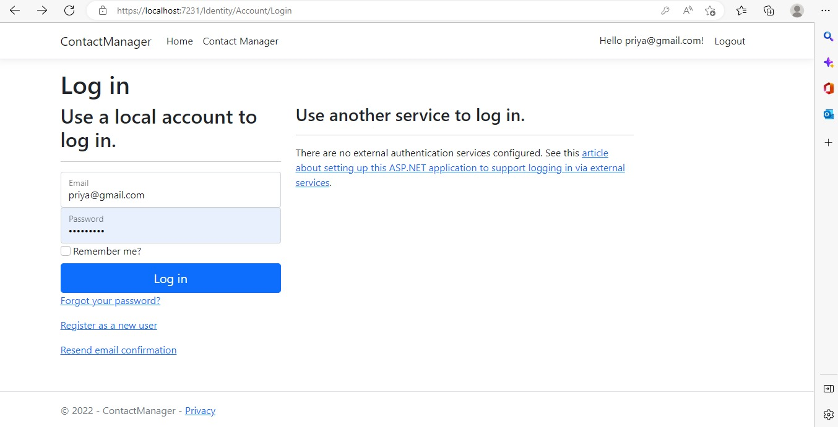
User Login page

Slide 22

User Home Page:

Slide 23
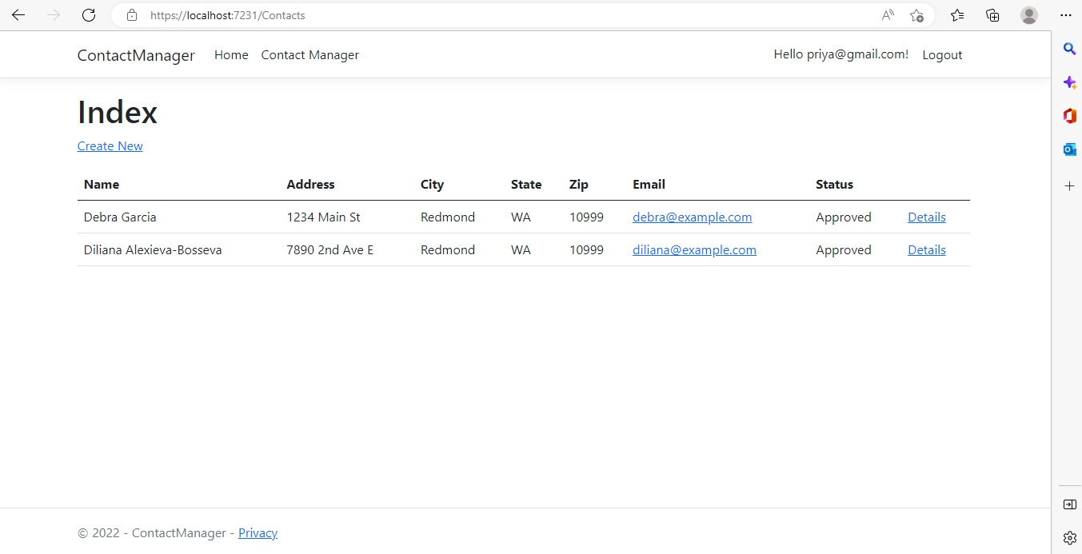
User side Data Access:
User can only view/access the Approved Contact Data.

Slide 24
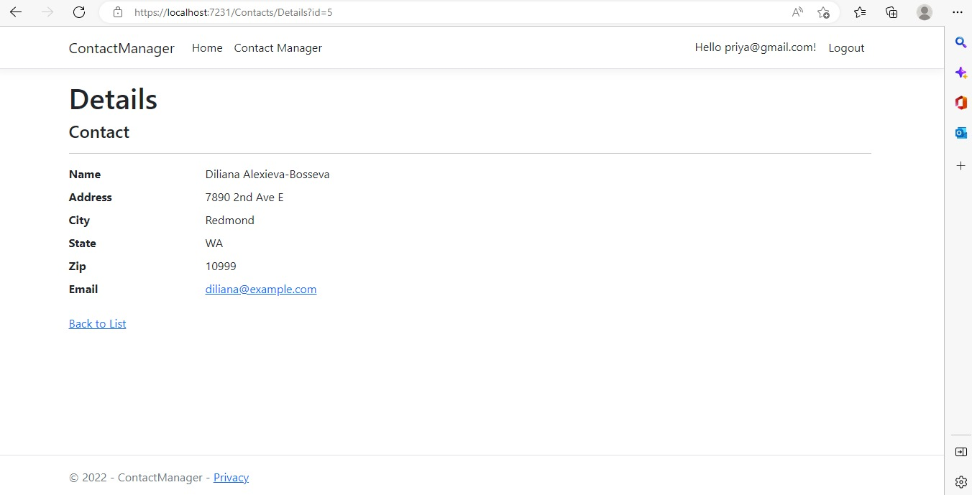
User can only View the Contact Data

Slide 25
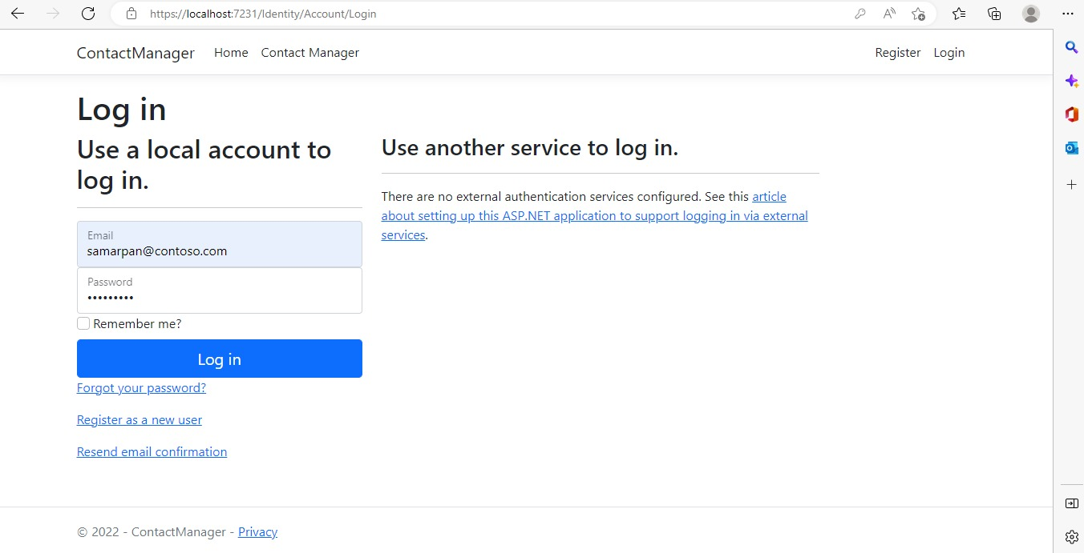
Manager Login:

Slide 26
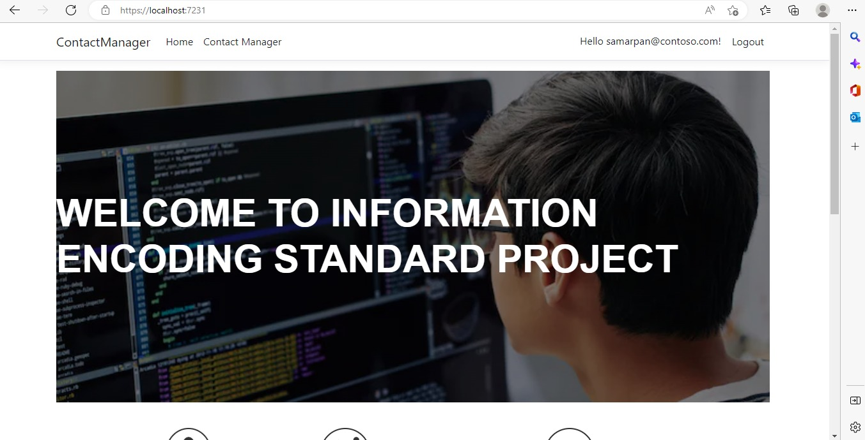
Manager Home Page:

Slide 27
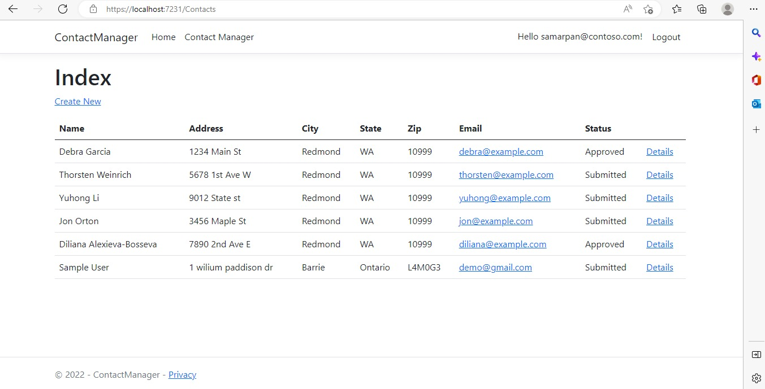
Manager side contact data access

Slide 28
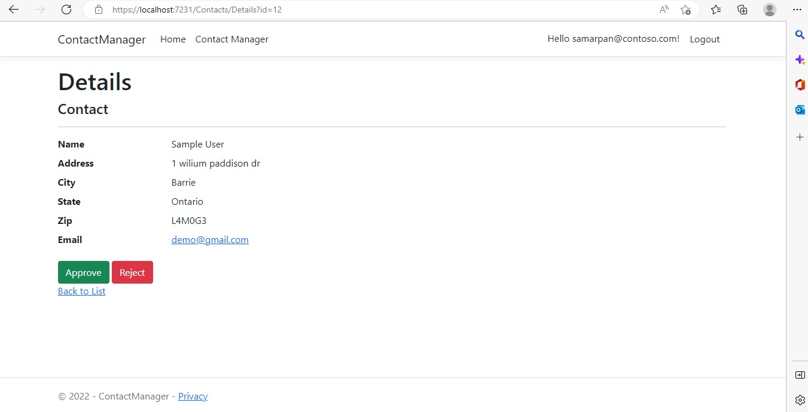
Admin Side : Contact Details Page
Here we can see the Manager can only Approve and Reject the Submitted Contact Data.

Slide 29
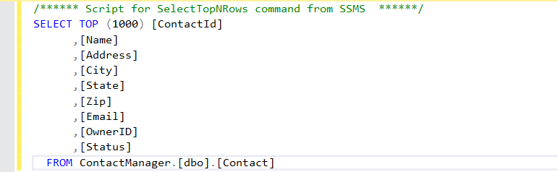
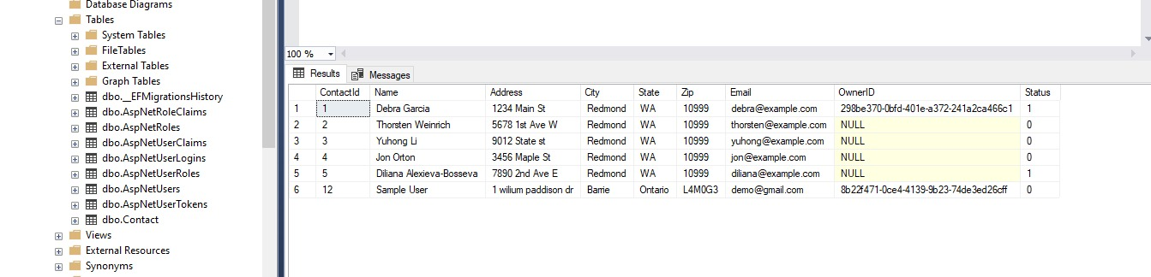
SSMS Database

Slide 30
Part 2: Security Technologies Recommendations

Slide 31
1) How can we transfer personal data securely within their network?
The best way to transfer data securely is through the use of a private key. This is a way that, when you send a message, it's encrypted and decrypted using a specific algorithm only you and the receiver know.
There are a couple of ways to transfer personal data within their network the safest way is by using Encryption along with the protocol.

Slide 32
2) What security protocol is best for transferring personal files?
Previously the FTP was widely preferred to transfer the data over the network, for more security purpose few new protocols were widely used for transferring personal file.
Top secure file transfer protocols include SFTP, FTPS, and AS2. Each of these offers stronger encryption than standard FTP, as well as additional safeguards, including keys, passwords, and certificates to authenticate users or connections.
SFTP is a protocol developed by the Internet Engineering Task Force (IETF) and is probably the most widely used file transfer protocol today. SFTP utilizes Secure Shell encryption to encrypt transmitted data

Slide 33

3) Can we encode and encrypt images?
A picture can be encrypted in the same way that text is encrypted by software. By running a sequence of mathematical operations, called an algorithm, on the binary data that comprises an image, encryption software changes the values of the numbers in a predictable way.
Usually, Images are encoded in Base64 formats. Base64 encoding converts the binary data into text format, which is passed through communication channel where a user can handle text safely.

Slide 34
4) Our database cannot be moved from the site and we need to be able to access it externally using a secure
Using JSON Web Tokens (JWTs) in authenticating and authorizing API clients

Slide 35
5) Can you recommend a secure framework for coding an API?
API architecture refers to the technical framework of developing a software interface that exposes backend data and application functionality for use in external applications. An API architecture consists of components for external interfacing, traffic control, runtime execution of business logic, and data access.

Slide 36
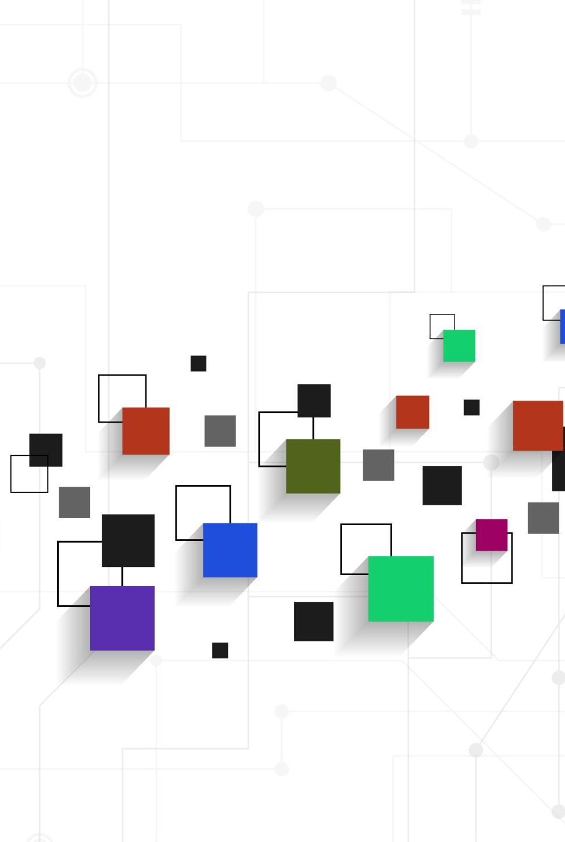
6) What data interchange format should we use while transferring data between locations?
Data Exchange Format means a machine readable data format intended or suitable for redistribution or sharing of data between software applications as determined by Licensor
JSON is the leading data interchange format for web applications and more. JSON, or JavaScript Object Notation, is a format used to represent data.

Slide 37

7) How should we store our data in our many locations?
To protect important data from loss or inappropriate disclosure, follow thing should be considered.
Store encrypted data on all devices
Store into more than one copy (Depends on data size and budget of an organization. Cloud is the best option)
Keep the data backup in encrypted form.

Slide 38
8) What are the ethical concerns related to the transmission of personal data?
Freedom from unauthorized access to private data.
Inappropriate use of data.
Accuracy and completeness when collecting data about a person or persons (corporations included) by technology.
Availability of data content, and the data subject's legal right to access; ownership.
Some other concerns:
Transparency
Accountability
Equality

Slide 39

GitHub Repo Link:
https://github.com/potatopoutato/IES-Authorization-and-Authentication

Slide 40

Thank you!!

